Slide 1
ETC Programmer Workshop 2: Finite State Machines (FSM)

Slide 2
Pre-requisites
You should already be familiar with Unity.
You are expected to understand ScriptableObjects!
Otherwise, watch this: https://youtu.be/PVOVIxNxxeQ
I expect you to know what Object-Oriented Programming is.
This isn’t intro to programming.
Slides & Unity examples can be found here.
https://github.com/TypeDefinition/ETC-Programmer-Workshops

Slide 3
What is a FSM?
But why do I want to use it?
Almost everything can be a state machine.
A gun is a state machine.
An enemy AI is a state machine.
A game manager is a state machine.
You are a state machine.
Your friends are state machines.
Your fish is a state machine.
Think of it as a glorified switch-case.

Slide 4
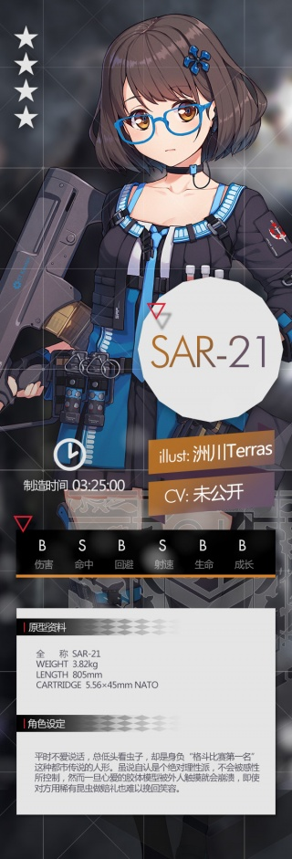
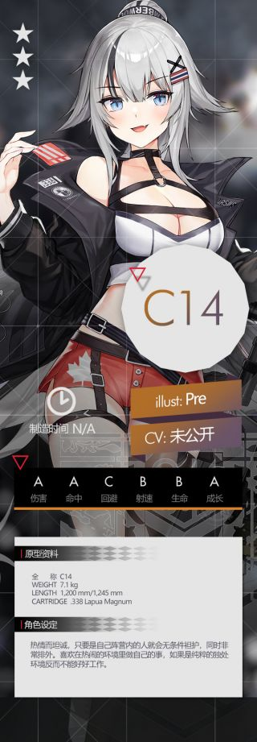
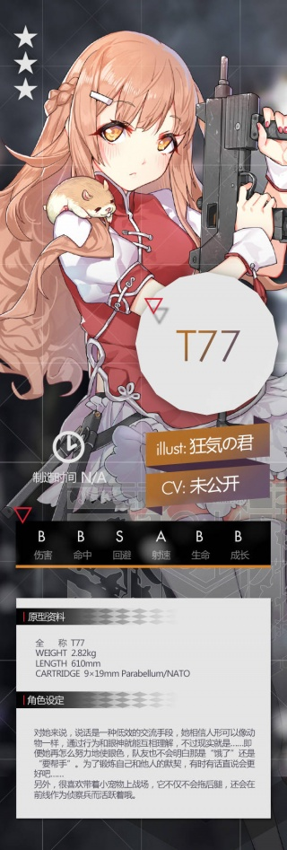
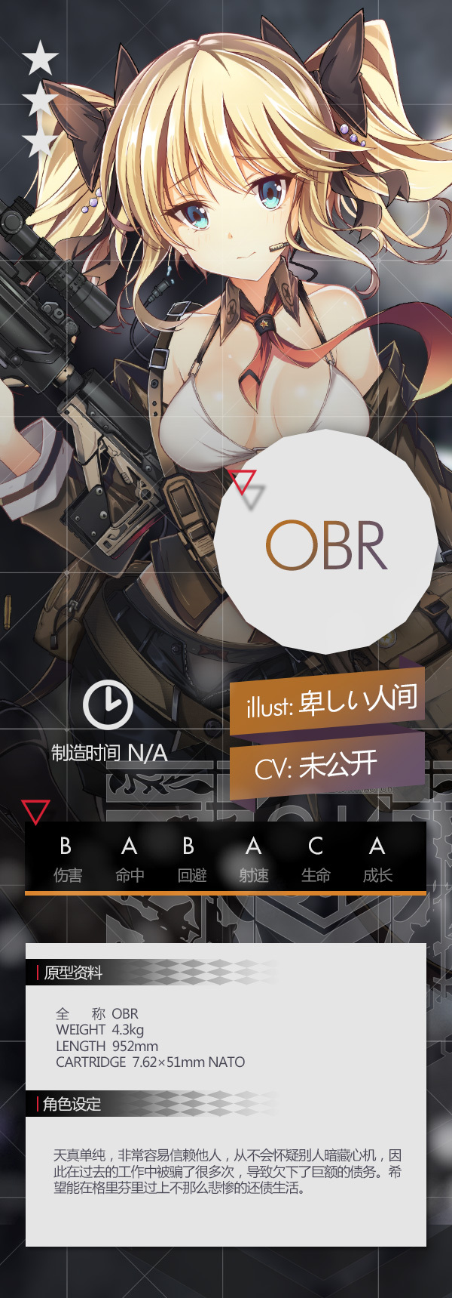
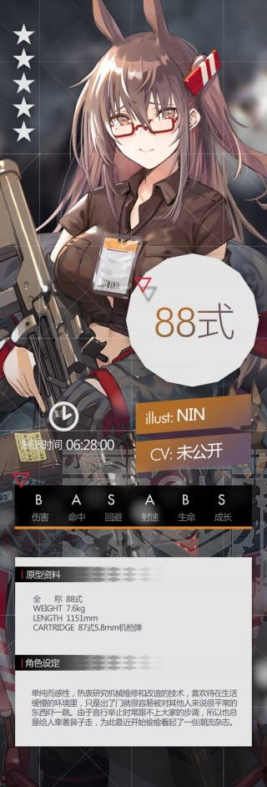
Example 1 - Guns Go Pew Pew!
So you want to make a shooter game.
Sucks to be you, it’s the one thing you can’t do in BVW.
That’s why I’m using it our main example.

Slide 5

Things to consider when programing a gun.
Is it shooting?
Is it reloading?
Is the gun cocked?
Is the gun out of ammo?
Is it shooting bullets or the grenade launcher?
Can it shoot while reloading?
Can it shoot when there’s no bullets?
And many more…

Slide 6
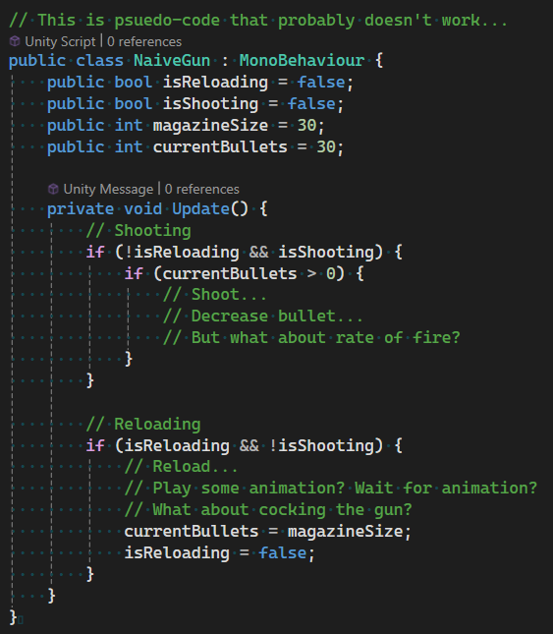
Let’s use some booleans!
Lots of if-statements.
Gets complicated very quickly.
It’s hard to understand.
It’s hard to extend.
It’s just terrible.
I know some of you have done this for BVW Round 1.
For your sanity, please don’t do this.

Slide 7
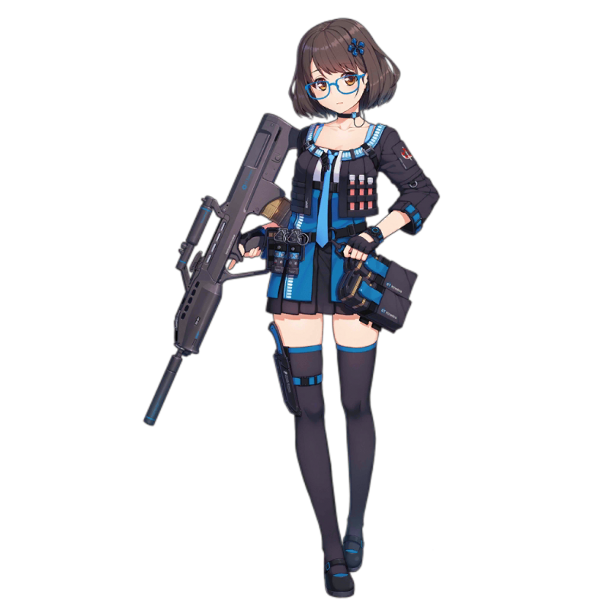
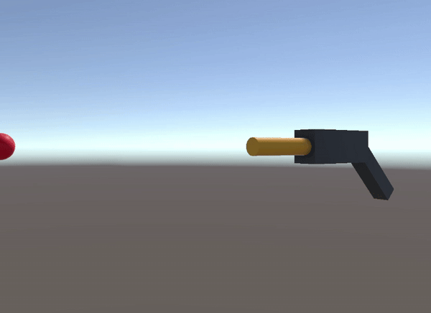
Why not break it down into states?
(Just 3 for now.)
SEMI-AUTO
FULL-AUTO
RELOAD

Slide 8
Practical Demo In Unity…

Slide 9
General Design
The FiniteStateMachine class is only used to handle state transitions and updates.
States define the behaviour, but any persistent changes should be stored in the GameObject as a Component.
That is to say, States are stateless.
There are other ways to design an FSM. This is just how I chose to do it.

Slide 10
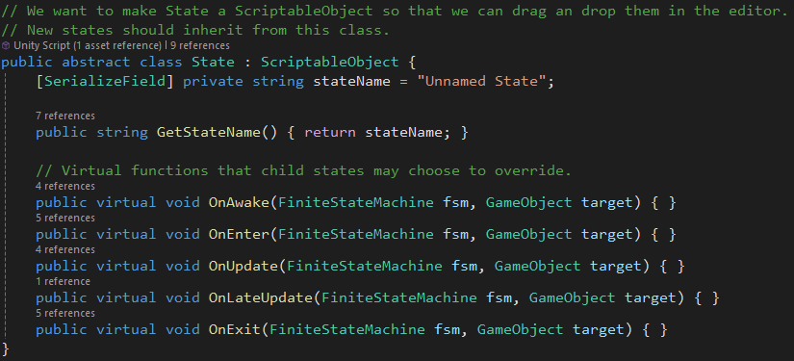
What happens in a state?

Slide 11
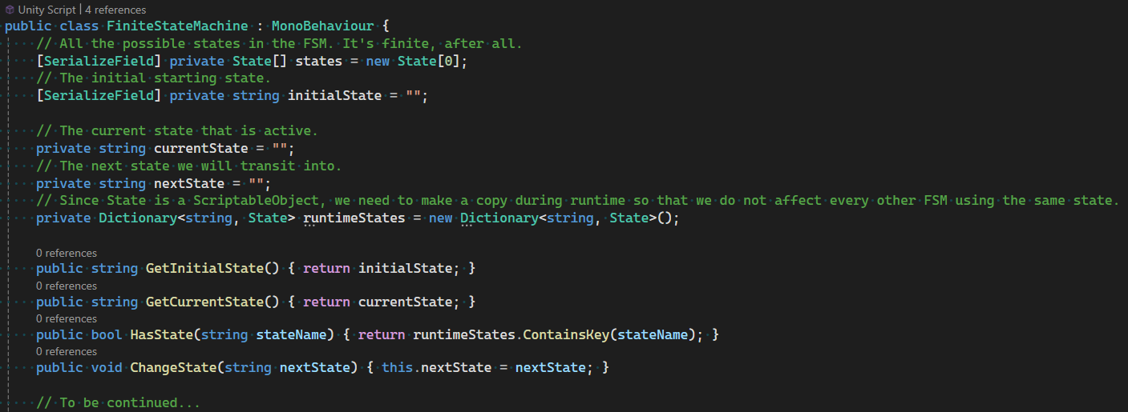
The FSM contains all possible states…

Slide 12
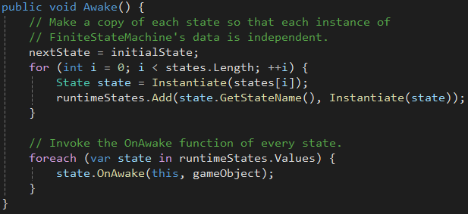
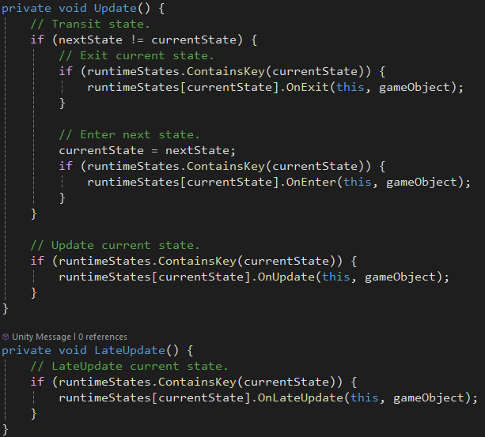
And handle state transitions.

Slide 13
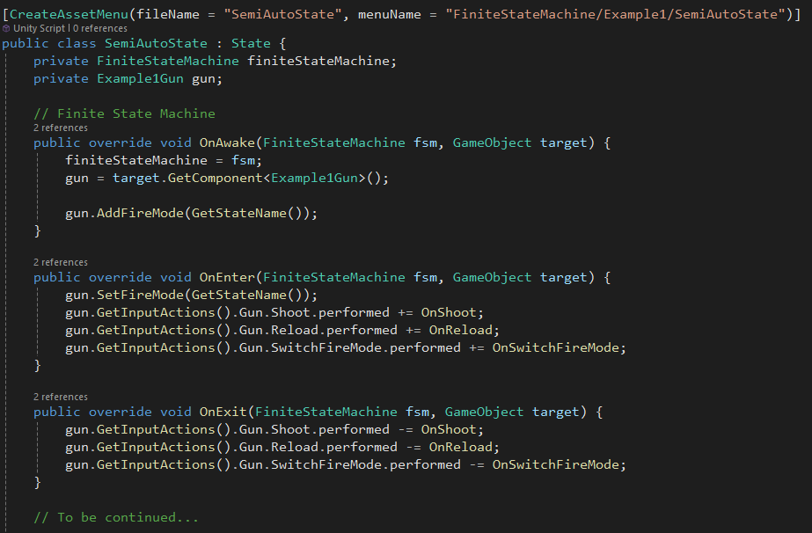
New states inherit from State class.

Slide 14
What else can be finite state machines?

Slide 15

Example 2 - Racing Game
Alrighty, no guns. Let’s make a racing game!
Racing games tend to have distinct states. FSM is suited for the game manager.
Countdown
Race
End

Slide 16


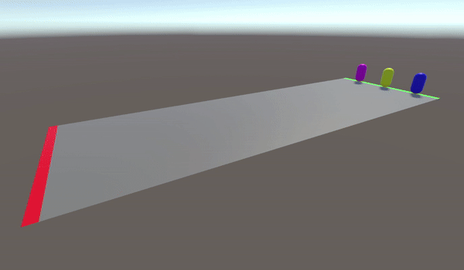
Race States
COUNTDOWN
Countdown
Spawn all players at start line.
Players cannot move.
Show countdown UI.
Race
Allow players to move.
End
Display results.
RACE
END

Slide 17
Many more things can be finite state machines! Even outside of games!

Slide 18
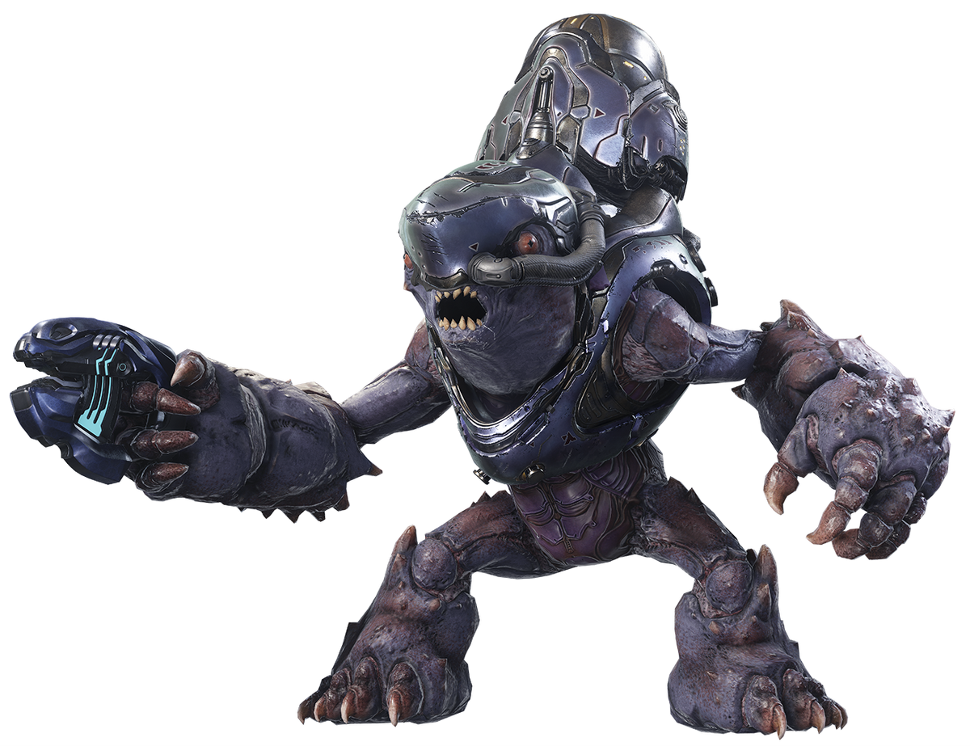
Enemy AI
IDLE
CHASE
DEAD
ATTACK

Slide 19
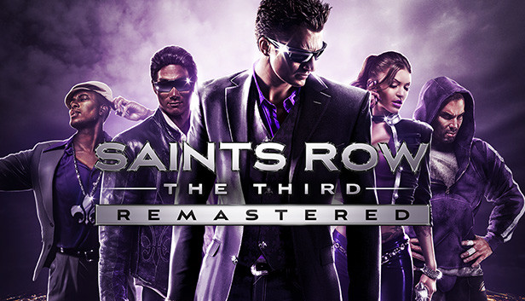
Open World Player
DRIVING
WALKING
DEAD
FLYING

Slide 20
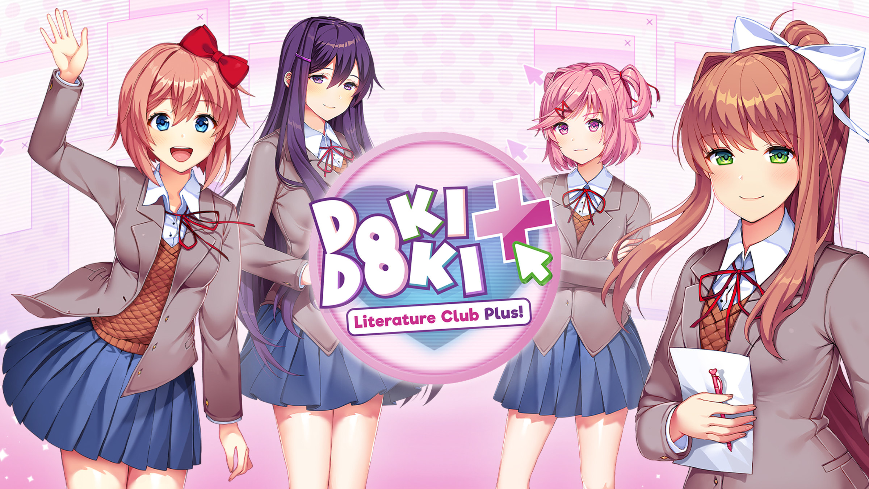
Romance Love Interest
DISLIKE
NEUTRAL
DEAD
LOVE

Slide 21
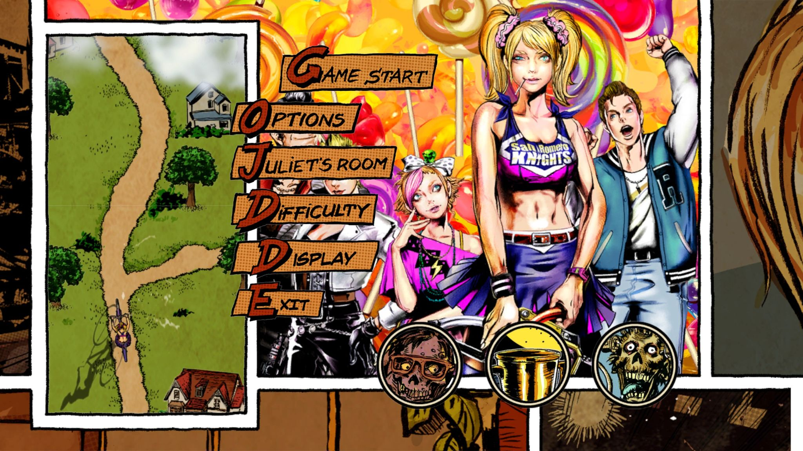
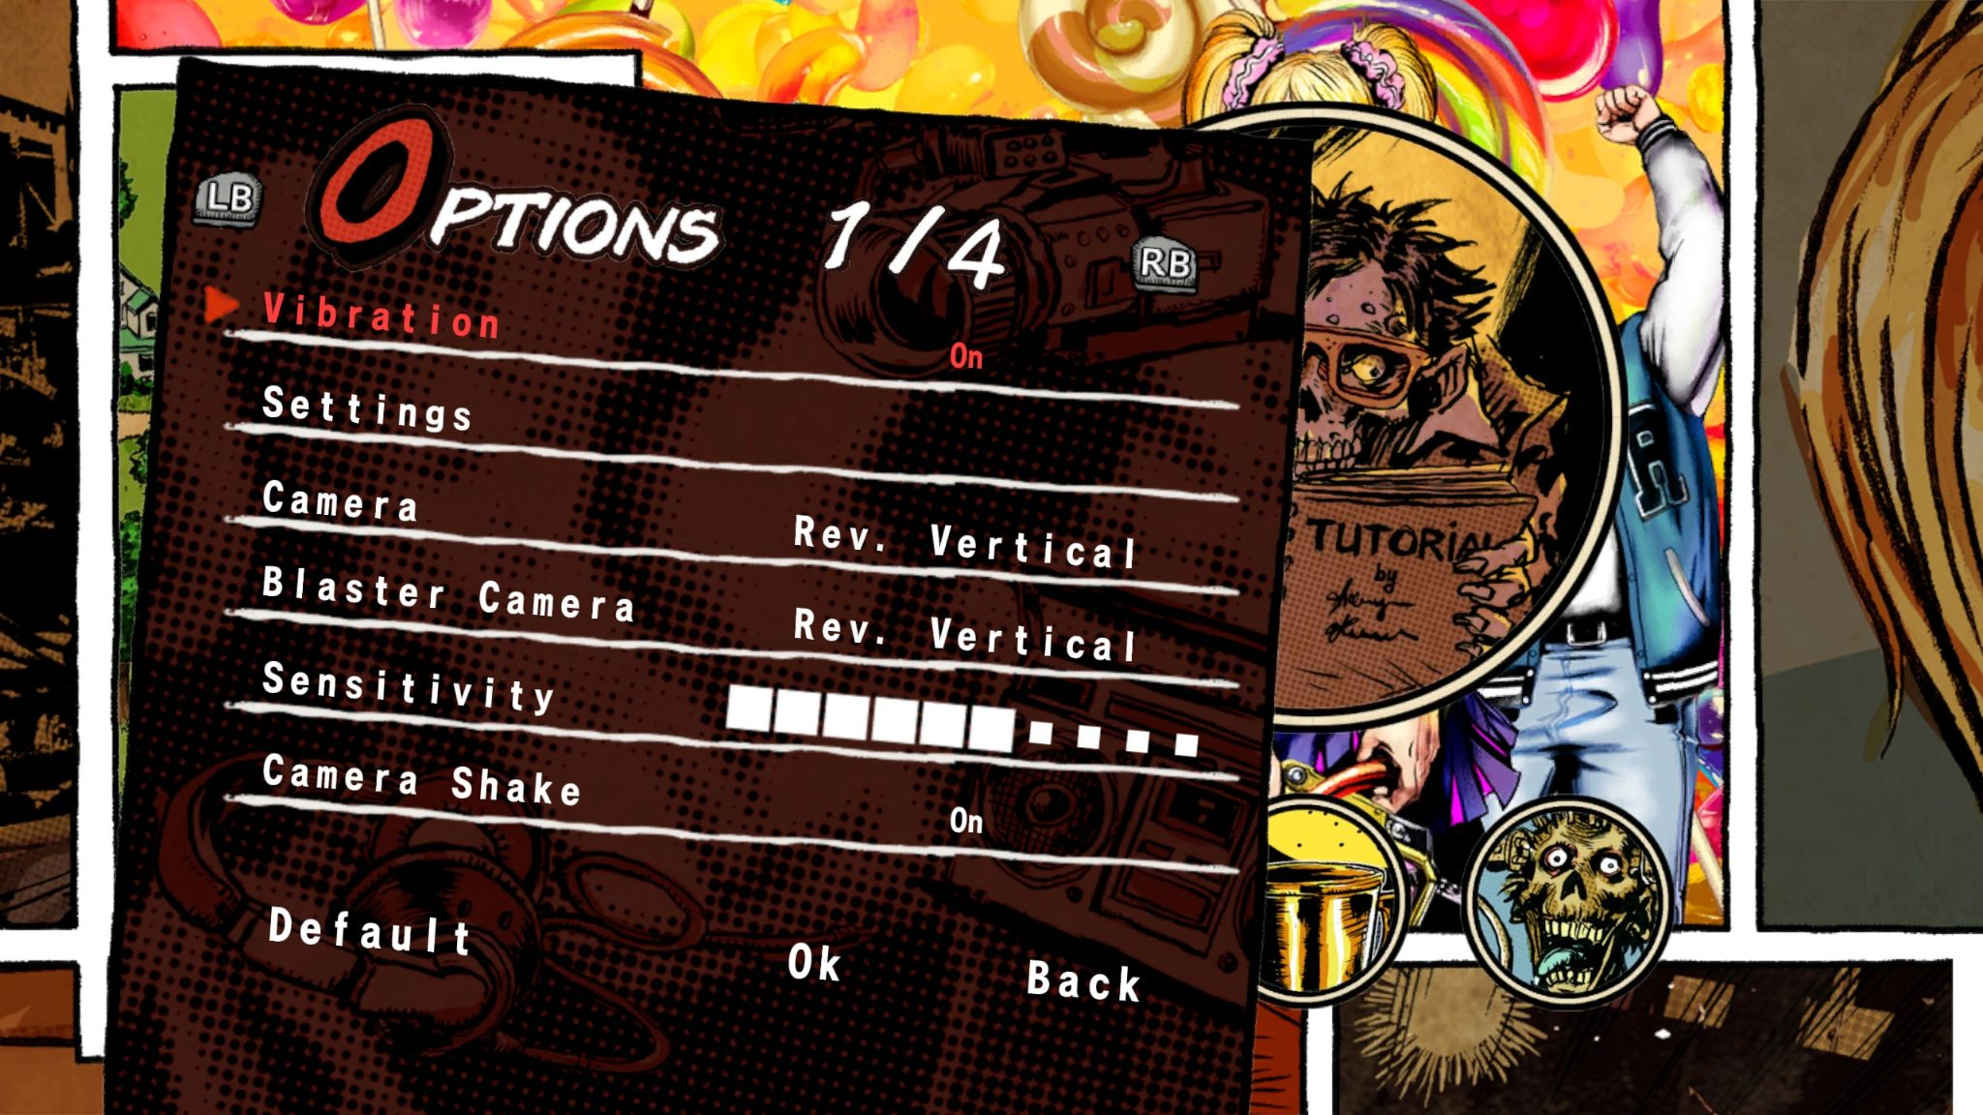
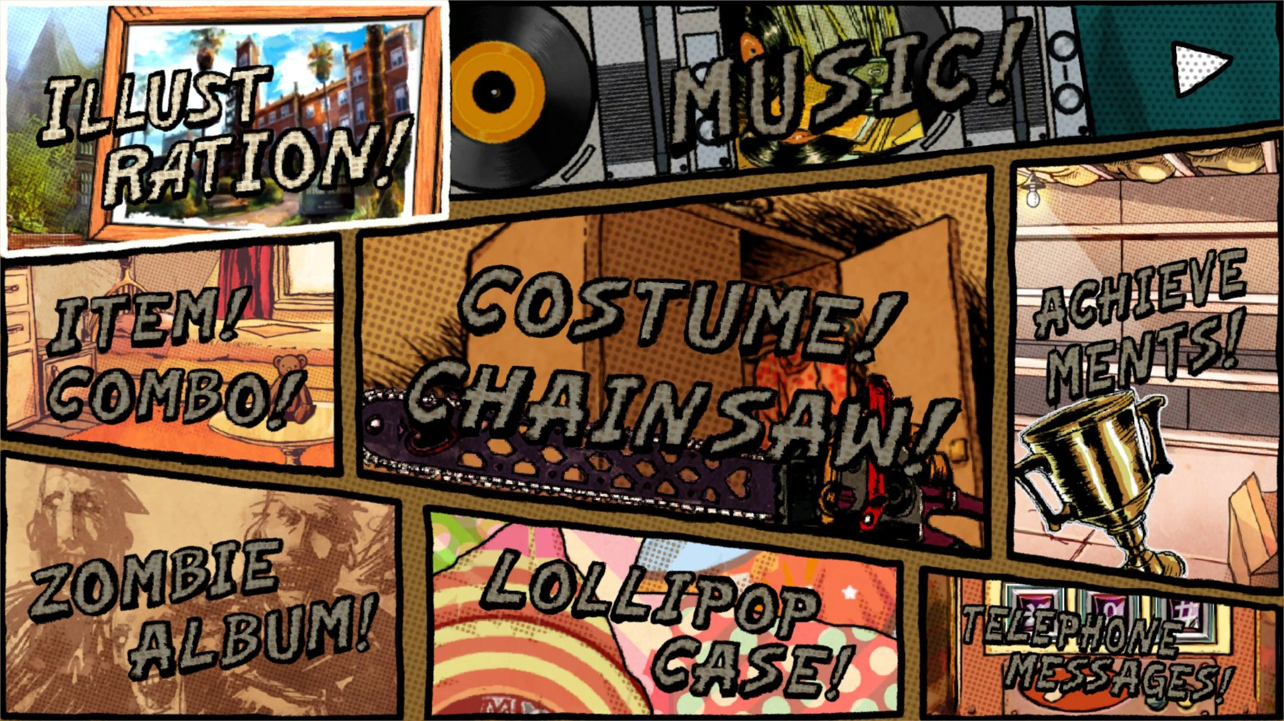
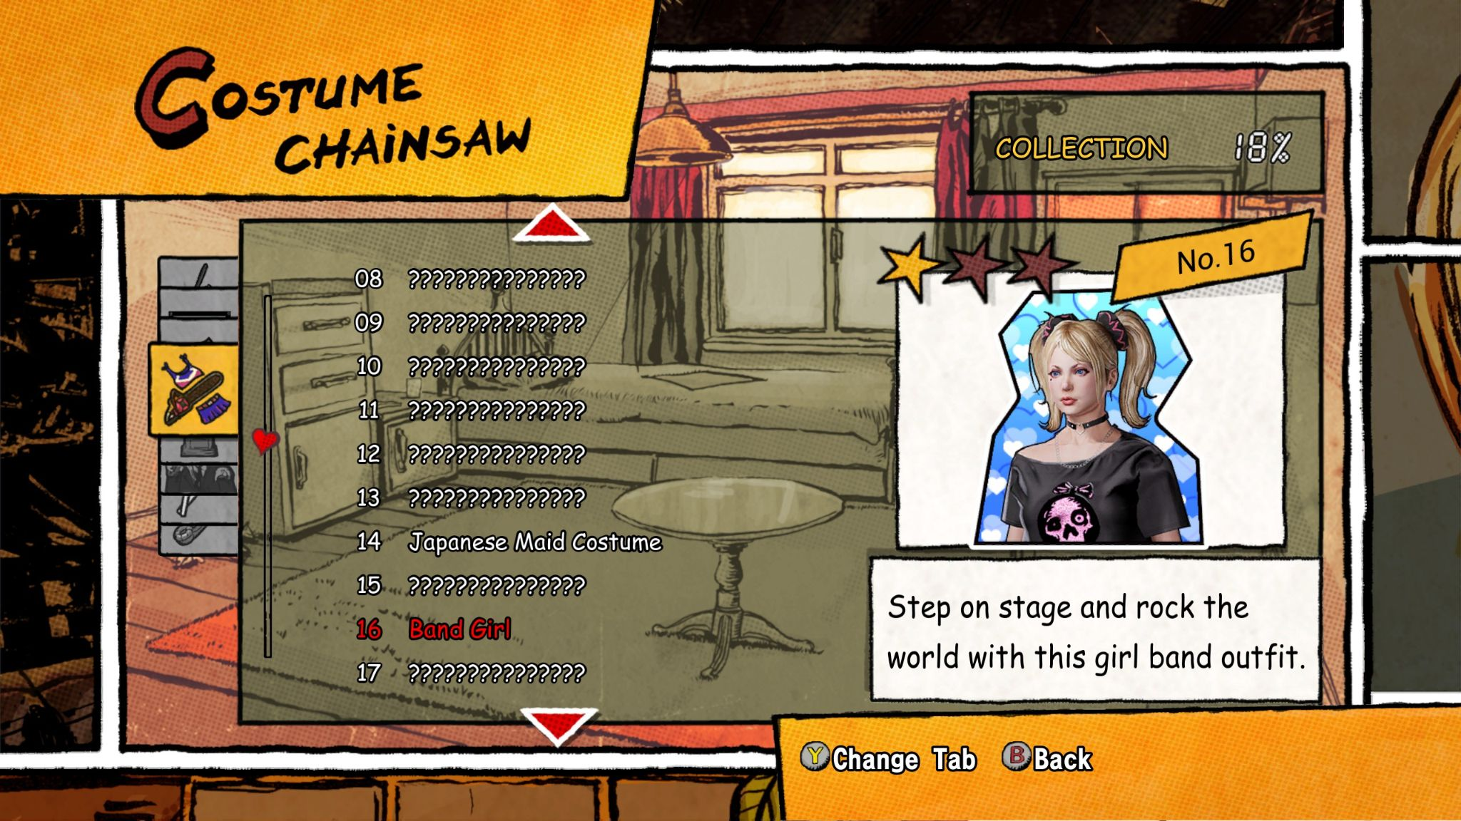
Game Menus

Slide 22
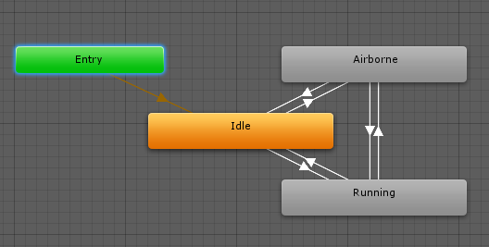
Animations

Slide 23
Fin.
Want to learn more game AI stuff?
Check out behaviour trees!
Images from Girls Frontline, Umamusume, Halo, Saints Row, Doki Doki Literature Club, Lollipop Chainsaw, and Unity Game Engine.

